Slide 1
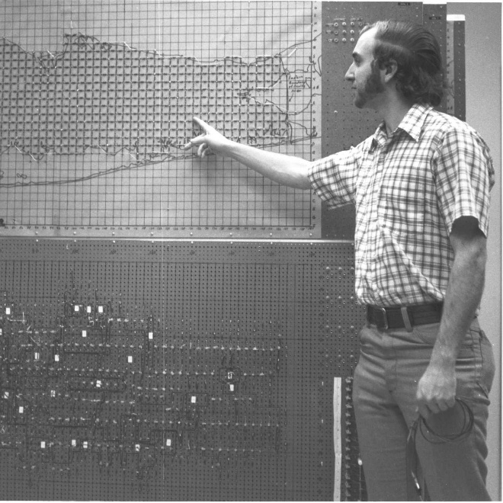
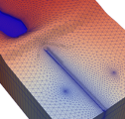
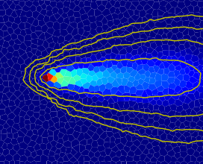







Numerical Solution Configuration & Diagnostics

Slide 2
Recap: the discretized flow equation

Slide 3
Picard iteration

Slide 4
Linear Solution methods

Slide 5
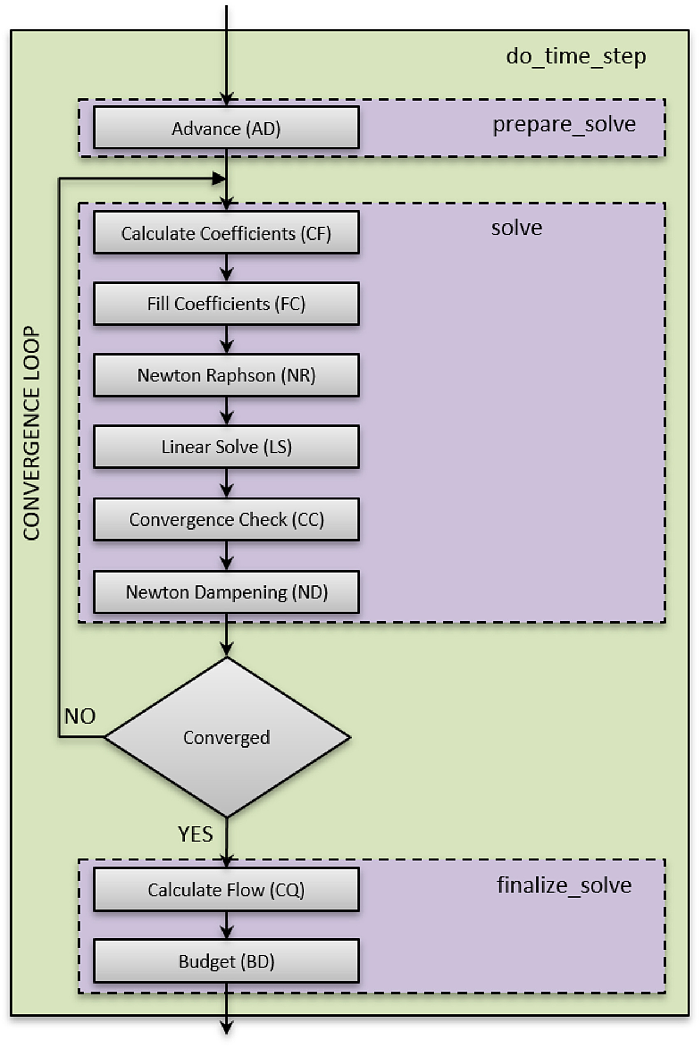
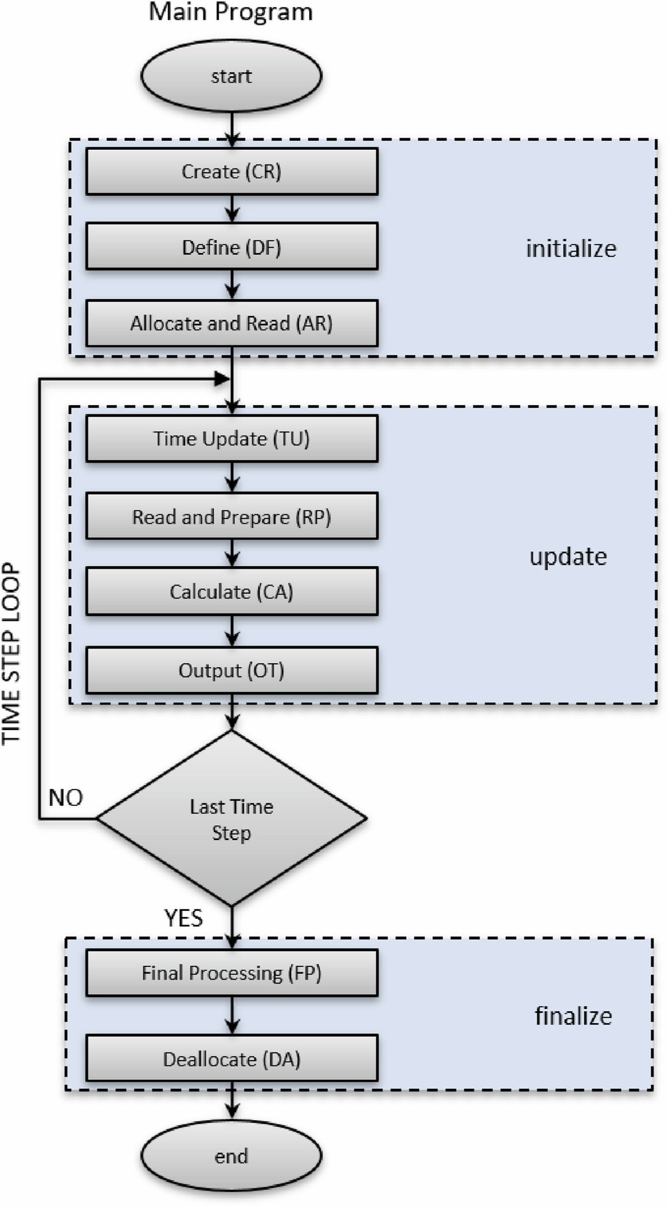
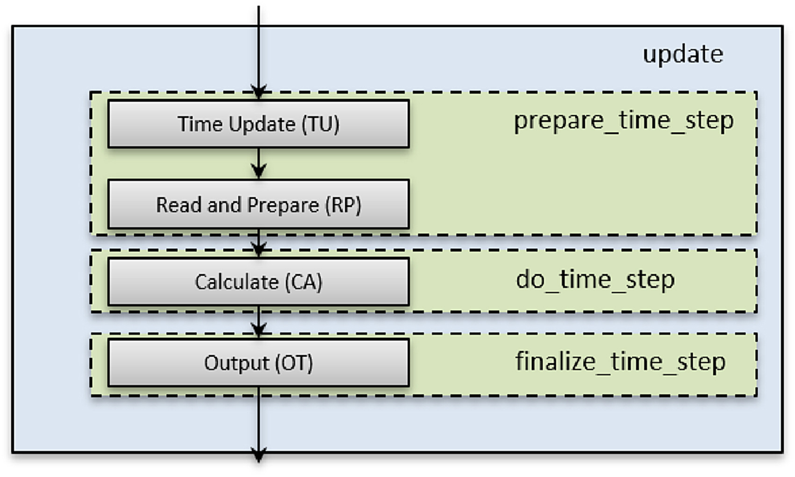
MODFLOW program flow chart

Slide 6
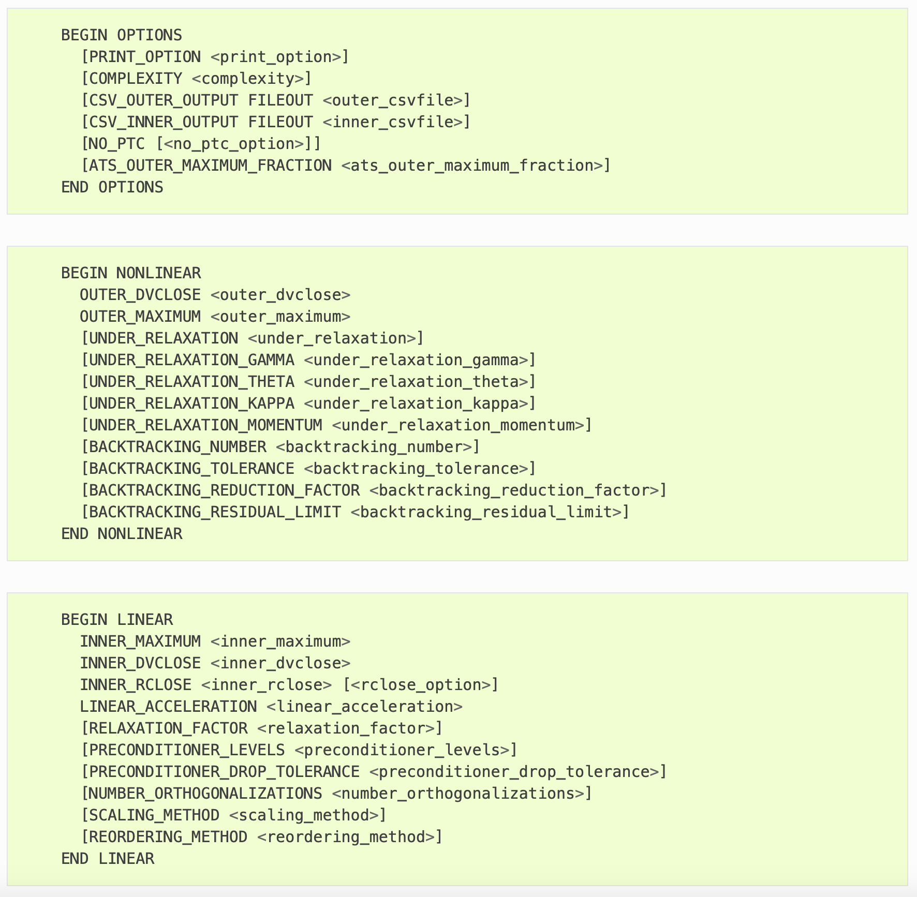
IMS basic settings
Non-Linear (Picard)
Maximum outer iterations
Outer dvclose (<= inner dvclose)
Linear
Linear accelerator (CG, BICGSTAB)
Maximum inner iterations
Inner dvclose
Inner rclose
Infinity norm (max residual)
Infinity norm – strict
L2-norm
Relative based on L2-norm
IMS file:

Slide 7
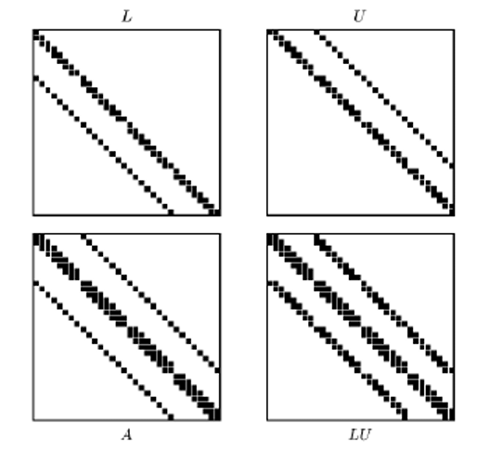
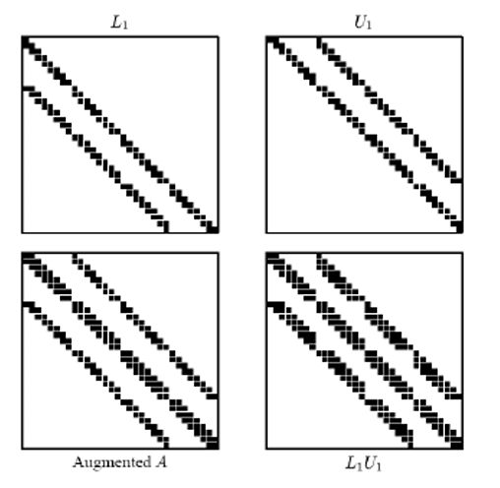
IMS preconditioner settings
Incomplete LU factorization
Zero-fill (ILU0) – preconditioner_levels = 0
Level-fill (ILUT) – preconditioner_levels > 0
Drop tolerance – preconditioner_drop_tolerance > 0
Relaxation factor – relaxation_factor > 0.0
IMS file:
https://doi.org/10.48550/arXiv.1308.5215

Slide 8
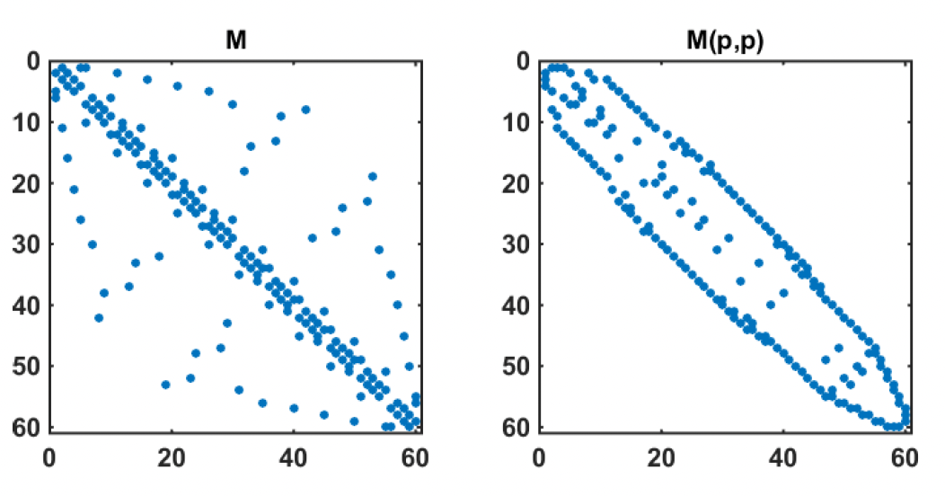
IMS miscellaneous linear settings
number_orthogalizations – recalculate residual from A and b rather than updating using solver coeffcients
scaling_method
none
diagonal
L2-norm
reordering_method
none
reverse Cuthill McKee ordering (rcm)
Minimum degree (md)
IMS file:
Darure (2017)

Slide 9
IMS non-linear convergence options
Pseudo transient continuation (PTC)
Newton-Raphson
Steady-state stress periods
Under-relaxation
Simple
Cooley
Delta-Bar-Delta
Backtracking

Slide 10
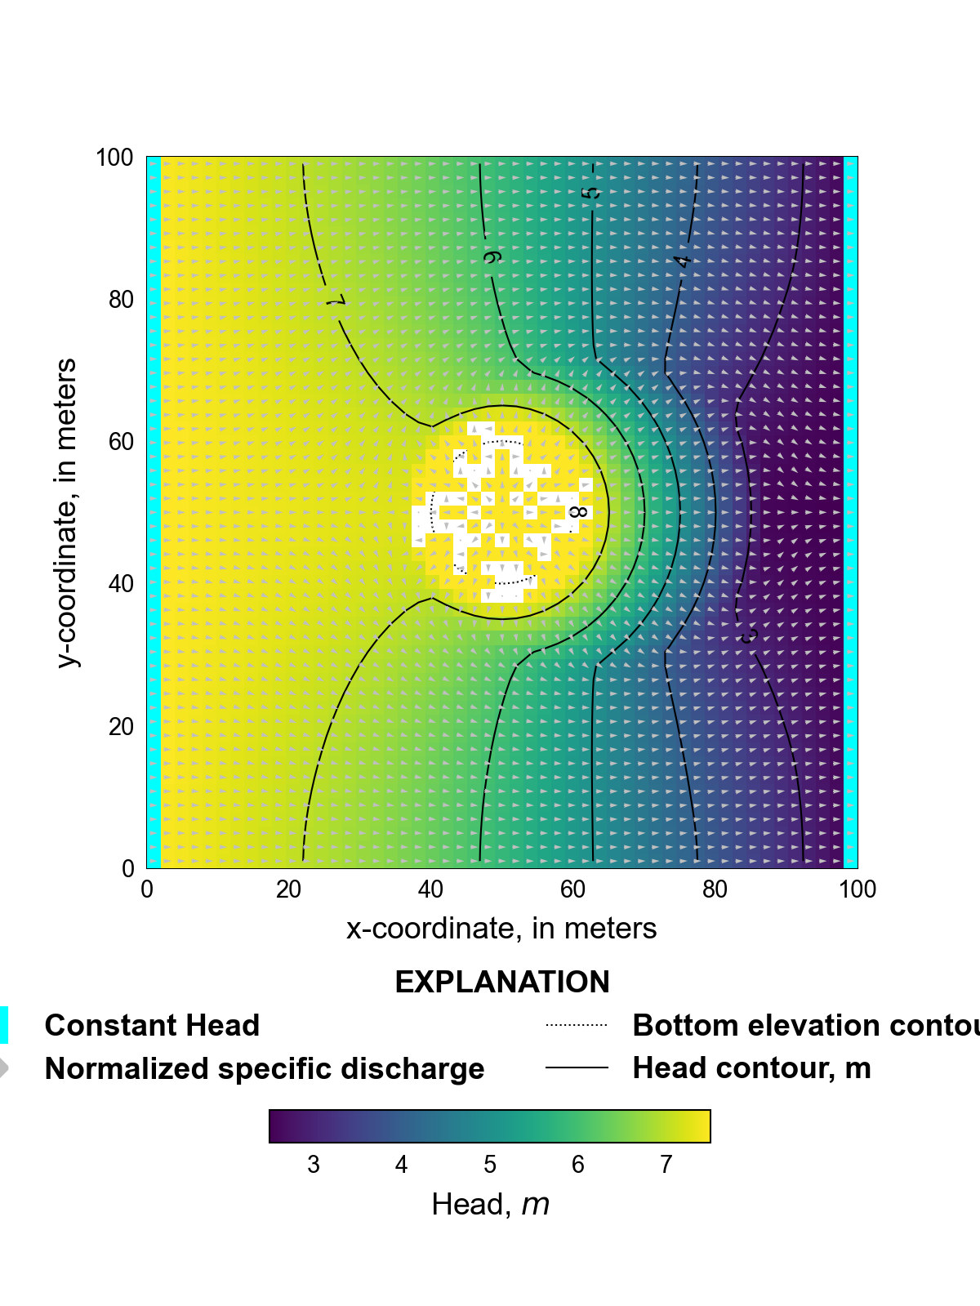
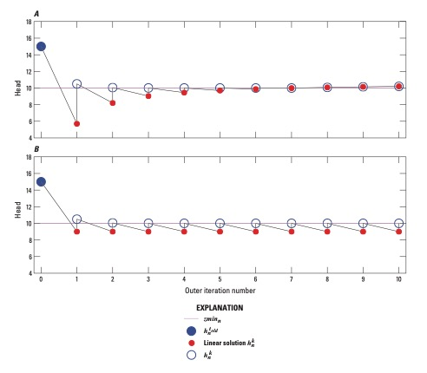
IMS non-linear convergence options (cont.)
Newton under-relaxation
Limit dependent-variable changes between consecutive nonlinear iterations in model cells and reduce the occurrence of dependent-variable values below the bottom-most elevation of a flow model
Defined in the model name file options block

Slide 11
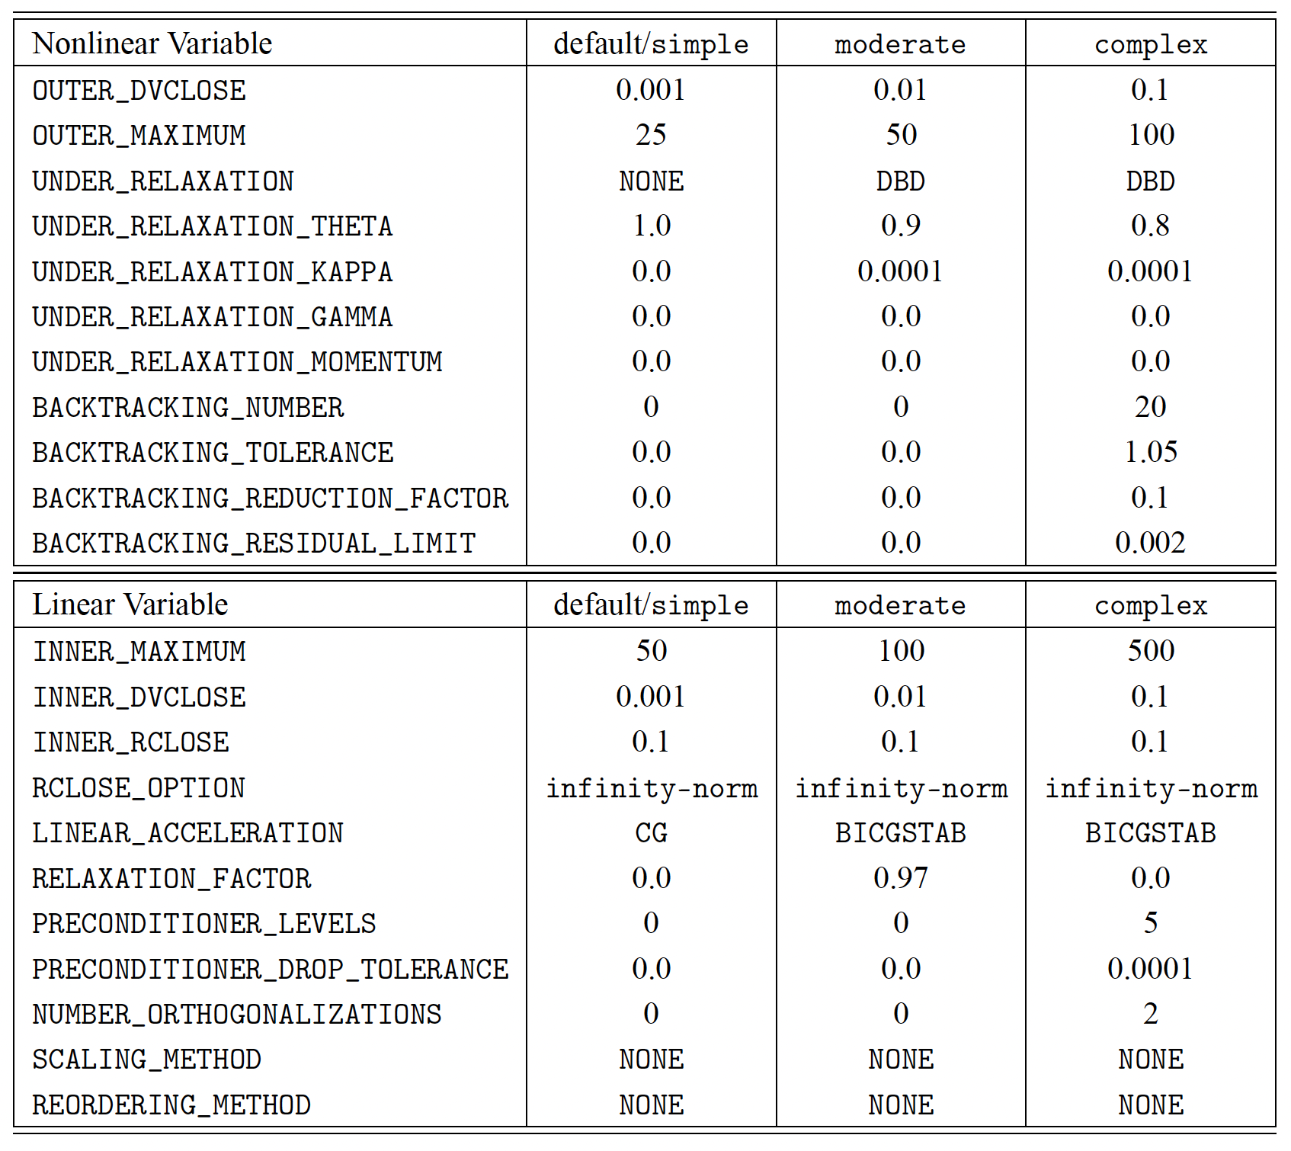
Getting started with IMS
Start with:
complexity = simple
default settings for IMS variables
relaxation_factor = 0.97
Groundwater problems with a lot of heterogeneity may need more inner iterations (inner_maximum) than the default value of 50

